Slide 1


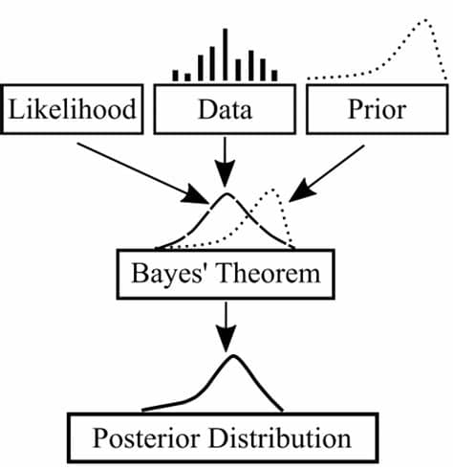

BITS Pilani
Pilani Campus
(some slides adapted from Stuart http://aima.cs.berkeley.edu/)
DSE CL 557 - Artificial and Computational Intelligence
#13. Probabilistic Representation and Reasoning – Contd..
Sunday, December 27, 2020
Dr. Saikishor Jangiti

Slide 2
Today
Probabilistic Representation and Reasoning
Representation of Conditional Independence using BN
Exact Inference - by enumeration and variable elimination
Need for Approximate Inference - direct Sampling
Reference: Chapter 13, 14.1 & 14.2 from AI: A modern approach (Russell, Norvig)

Slide 3
Bayesian networks
A simple, graphical notation for conditional independence assertions and hence for compact specification of full joint distributions
Syntax:
a set of nodes, one per variable
a directed, acyclic graph (link ≈ "directly influences")
a conditional distribution for each node given its parents:
P (X_{i} | Parents (X_{i}))
In the simplest case, conditional distribution represented as a conditional probability table (CPT) giving the distribution over X_{i} for each combination of parent values

Slide 4
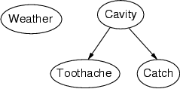
Example
Topology of network encodes conditional independence assertions:
Weather is independent of the other variables
Toothache and Catch are conditionally independent given Cavity

Slide 5
Example
I'm at work, neighbor John calls to say my alarm is ringing, but neighbor Mary doesn't call. Sometimes it's set off by minor earthquakes. Is there a burglar?
Variables: Burglary, Earthquake, Alarm, JohnCalls, MaryCalls
Network topology reflects "causal" knowledge:
A burglar can set the alarm off
An earthquake can set the alarm off
The alarm can cause Mary to call
The alarm can cause John to call

Slide 6
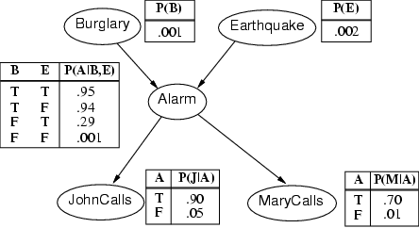
Example contd.

Slide 7
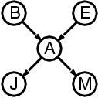
Compactness
A CPT for Boolean X_{i} with k Boolean parents has 2^{k} rows for the combinations of parent values
Each row requires one number p for X_{i} = true (the number for X_{i} = false is just 1-p)
If each variable has no more than k parents, the complete network requires O(n · 2^{k}) numbers
I.e., grows linearly with n, vs. O(2^{n}) for the full joint distribution
For burglary net, 1 + 1 + 4 + 2 + 2 = 10 numbers (vs. 2⁵-1 = 31)

Slide 8
Semantics
The full joint distribution is defined as the product of the local conditional distributions:
P (X₁, … ,X_{n}) = π_{i = 1} P (X_{i} | Parents(X_{i}))
e.g., P(j ∧ m ∧ a ∧ ¬b ∧ ¬e)
= P (j | a) P (m | a) P (a | ¬b, ¬e) P (¬b) P (¬e)

Slide 9
Constructing Bayesian networks
1. Choose an ordering of variables X₁, … ,X_{n}
2. For i = 1 to n
add X_{i} to the network
select parents from X₁, … ,X_{i-1} such that
P (X_{i} | Parents(X_{i})) = P (X_{i} | X₁, ... X_{i-1})
This choice of parents guarantees:
P (X₁, … ,X_{n}) = π_{i =1} P (X_{i} | X₁, … , X_{i-1}) (chain rule)
= π_{i =1}P (X_{i} | Parents(X_{i})) (by construction)

Slide 10
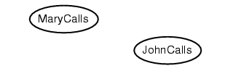
Example
Suppose we choose the ordering M, J, A, B, E
P(J | M) = P(J)?

Slide 11
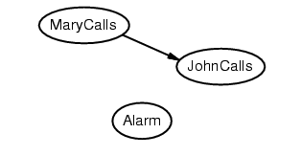
Example
Suppose we choose the ordering M, J, A, B, E
P(J | M) = P(J)? No
P(A | J, M) = P(A | J)? P(A | J, M) = P(A)?

Slide 12
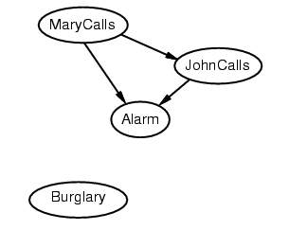
Example
Suppose we choose the ordering M, J, A, B, E
P(J | M) = P(J)?No
P(A | J, M) = P(A | J)?
P(A | J, M) = P(A)? No
P(B | A, J, M) = P(B | A)?
P(B | A, J, M) = P(B)?

Slide 13
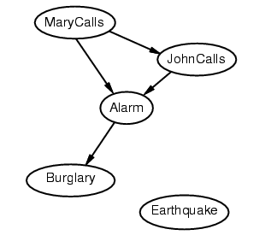
Example
Suppose we choose the ordering M, J, A, B, E
P(J | M) = P(J)? No
P(A | J, M) = P(A | J)? P(A | J, M) = P(A)? No
P(B | A, J, M) = P(B | A)? Yes
P(B | A, J, M) = P(B)? No
P(E | B, A ,J, M) = P(E | A)?
P(E | B, A, J, M) = P(E | A, B)?

Slide 14
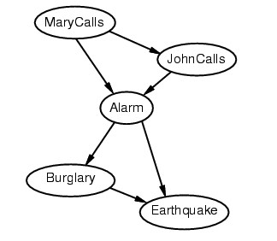
Example
Suppose we choose the ordering M, J, A, B, E
P(J | M) = P(J)? No
P(A | J, M) = P(A | J)? P(A | J, M) = P(A)? No
P(B | A, J, M) = P(B | A)? Yes
P(B | A, J, M) = P(B)? No
P(E | B, A ,J, M) = P(E | A)? No
P(E | B, A, J, M) = P(E | A, B)? Yes

Slide 15
Example contd.
Deciding conditional independence is hard in noncausal directions
(Causal models and conditional independence seem hardwired for humans!)
Network is less compact: 1 + 2 + 4 + 2 + 4 = 13 numbers needed

Slide 16
Some special cases in Network Construction – Noisy OR

Slide 17
Some special cases in Network Construction – Noisy OR

Slide 18
Some special cases in Network Construction – Noisy OR

Slide 19
Handling continuous distributions

Slide 20
Applications

Slide 21
Inference Tasks

Slide 22
Inference by enumeration

Slide 23
Inference by enumeration

Slide 24
Inference by enumeration

Slide 25
Variable elimination

Slide 26
Variable elimination

Slide 27
Variable elimination

Slide 28
Variable elimination

Slide 29
Irrelevant variables

Slide 30
Complexity of Exact Inference

Slide 31
Summary
Bayesian networks provide a natural representation for (causally induced) conditional independence
Topology + CPTs = compact representation of joint distribution
Generally easy for domain experts to construct

Slide 32
Thank you for your Attention
Any more queries

